Slide 1





A Mathematical and Practical Study of the PRESENT Cipher
•Lazaros Papakostas
•International Hellenic University
•Course: Data Protection and Cryptography
•Professor: Dr. Stavrinides

Slide 2
Table of Contents
What is the PRESENT Cipher?
Internal Structure of PRESENT
AddRoundKey & sBoxLayer
Permutation Layer
Key Scheduling Process (80-bit Key)
Decryption Process
Mathematical Foundations
One-Round Example

Slide 3
What is the PRESENT Cipher?
A lightweight block cipher, introduced in 2007 by Orange Labs, Ruhr University Bochum, Technical University of Denmark
Renowned for its smaller size, about 2.5 smaller than AES
64-bit block size
Key size: 80 or 128 bits
31 rounds
4-bit S-box
ISO/IEC 29192-2 standard
Hardware-oriented, low-power, small-area footprint

Slide 4
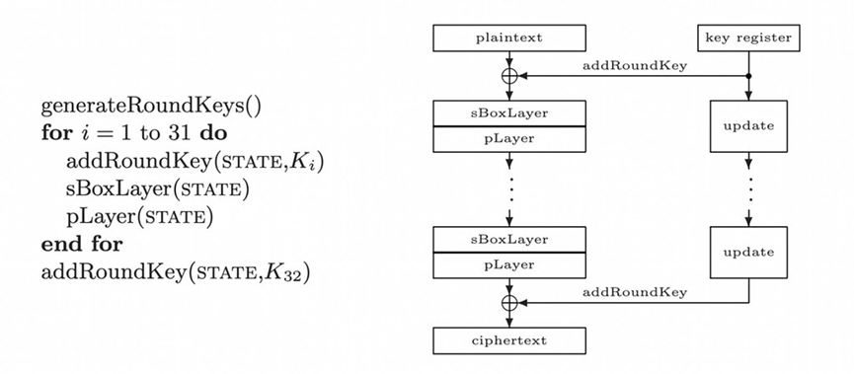
Internal Structure of PRESENT
Structure of the cipher:
AddRoundKey step: XOR with round key
Substitution Layer (sBoxLayer): 16 × 4-bit S-boxes
Permutation Layer (pLayer): Bit-wise permutation
Repetition of all 3 steps for 31 rounds
Application of final whitening key after last round

Slide 5

AddRoundKey & sBoxLayer
AddRoundKey:
XORs current 64-bit state with 64-bit round key
Each round key is derived from master key
For round i, round key k^{i} =k₆₃^{i}….k₀^{i} is XORed with the data b_{j} b_{j} →b_{j}⊕k_{j}^{i}
sBoxLayer:
Division of state into 16 × 4-bit nibbles
Application of substitution by S-box
Introduction of non-linearity and confusion

Slide 6
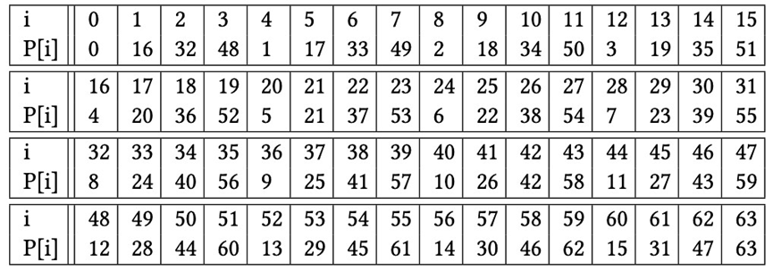
Permutation Layer
Rearrangement of 64 bits via a fixed permutation table
Enhances diffusion

Slide 7
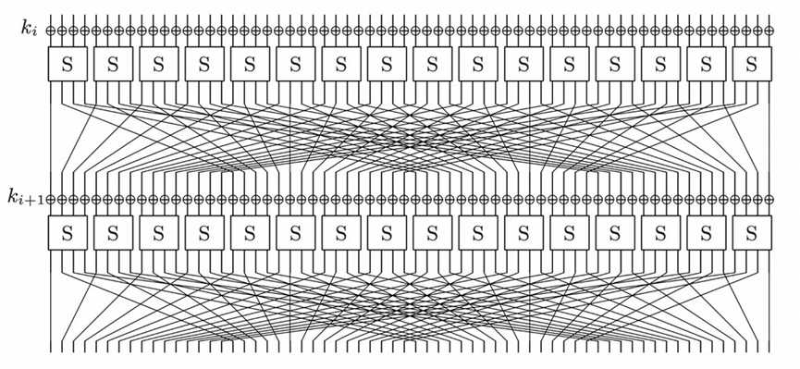
Permutation Layer
Each output bit depends on bits from multiple S-box outputs

Slide 8
Key Scheduling Process (80-bit Key)
Each round key is generated as follows:
1. Left rotate the 80-bit master key by 61 positions
K₇₉K₇₈…K₁K₀ = K₁₈K₁₇…K₂₀K₁₉
2. Apply the S-box to the 4 most significant bits
K₇₉K₇₈K₇₇K₇₆ = S[K₇₉K₇₈K₇₇K₇₆]
3. XOR bits [19:15] with round counter
K₁₉K₁₈K₁₇K₁₆K₁₅ = [K₁₉K₁₈K₁₇K₁₆K₁₅] ⊕ roundcounter
Then extract the leftmost 64 bits as the round key

Slide 9
Decryption Process
Same round keys used in reverse order
Inverse operations applied:
Inverse pLayer
Inverse S-box substitution
AddRoundKey (self-inverse)
Ciphertext is restored to original plaintext

Slide 10
Mathematical Foundations
PRESENT follows the Substitution-Permutation Network (SPN) model
Round function: R_{i}(X) = P(S(X ⊕ K_{i}))
X: 64-bit state
K_{i}: 64-bit round key
⊕ denotes bitwise XOR
S: S-box
P: Permutation

Slide 11
Mathematical Foundations
S-box
A non-linear Boolean function
S:{0,1}⁴→{0,1}⁴
S-box Properties, critical to cipher’s security
Non-linearity
Differential uniformity
Avalanche effect
P-layer formula
P(i)=16 ⋅ i mod3, for 0 ≤i≤62, P(63)=63
Enhances diffusion

Slide 12
Mathematical Foundations
AddRoundKey performs bitwise XOR
X ← X ⊕ Kᵢ
Combines the current state with the round key
Linear operation over finite field F₂
The PRESENT key schedule combines
Modular indexing (Bitwise rotation)
K′[i]=K[(i+61)mod80
Boolean non-linear substitution (S-Box Substitution)
K₇₉K₇₈K₇₇K₇₆ = S[K₇₉K₇₈K₇₇K₇₆]
Field operations over F₂
K₁₉K₁₈K₁₇K₁₆K₁₅ = [K₁₉K₁₈K₁₇K₁₆K₁₅] ⊕ roundcounter
​

Slide 13
One-Round Example
Setup
64-bit plaintext: 0x0000000000000000
64-bit round key: 0xFFFFFFFFFFFFFFFF
Using PRESENT S-box and P-layer
Step 1 - AddRoundKey (XOR):
0x0000000000000000 ⊕ 0xFFFFFFFFFFFFFFFF
Result: 0xFFFFFFFFFFFFFFFF
Step 2 - sBoxLayer:
Input: Sixteen 4-bit nibbles: F F F F …
S-box(F) = 2 → All become 2
Result: 0x2222222222222222

Slide 14
One-Round Example
Step 3 - pLayer (Permutation):
Apply: P(i) = (16 × i) mod 63, for i = 0–62; P(63) = 63
Sample mapping:
Bit 0 → Bit 0
Bit 1 → Bit 16
Bit 2 → Bit 32
Bit 3 → Bit 48
……..
Bit 63 → Bit 63
Result: 0x0888888888888888

